Slide 1
Lecture 6
Morphology
$

Slide 2
Knowledge of language
1. knowledge of sounds and sound patterns
2. knowledge of word structure and formation
3. knowledge of the structure of phrases and sentences
4. knowledge of the relationship between form and meaning, between meanings

Slide 3
What do we know when we know a word?
Words are associated with a wide range of information.

Slide 4
Contents
1. Morphological knowledge
morpheme
types of morphemes
organization of morphemes
2. Word-formation processes

Slide 5
words
- act, color, bike, virus, …
- interaction, colorful, motorbike, coronavirus, …
An indivisible unit is needed to describe words!

Slide 6
Morpheme
A morpheme is a minimal unit of meaning or grammatical function.
- boy, desire, …
- boyish, desirable, …
- boyishness, desirability, …

Slide 7
Types of Morphemes
Free vs Bound Morphemes
Their little dog bites the mailman.

Slide 8
Types of Morphemes
1. free morpheme
- lexical morphemes
- nouns, verbs, adjectives and adverbs
- open-class morphemes
- functional morphemes
- conjunctions, prepositions, articles, auxiliary verbs and pronouns
- closed-class morphemes

Slide 9
Types of Morphemes
2. bound morpheme
- affixes:
- prefixes: attached to the beginning of another morpheme (e.g., unlikely, impossible, reduce, rewrite)
- suffixes: attached to the end of another morpheme (e.g., carelessness, kindness, learnable)
- infixes, circumfixes in some languages
- bound base/stem morphemes (e.g., receive, reduce, … )
- contracted (shortened) forms (e.g. ‘ll, ‘ve, ‘d)

Slide 10
Affixes
derivational morphemes
- Morphemes that make new words or transform the root words into different grammatical categories.
- e.g., re-, pre-, ex-, mis-, co-, un-, …
-ful, -less, ish, ment, ly, …

Slide 11
inflectional morphemes
- Morphemes that mark properties (such as tense, number, person and so forth) of a word
- Noun + -’s, -s;
- Verb + -s, -ing, -ed, -en;
- Adjective + -er, -est
- Inflectional morphemes are always suffixes in English
- Inflectional morphemes always follow (if any) derivational morphemes in English.
- punish + ment + s
- learn + er + ’s

Slide 12
Allomorphs
– having different sounds or spellings
– carrying the same meaning or having the same grammatical function
the allomorphs of the morpheme “negation”
im: - possible
in: – competent
il: – legal
ir: – relevant
un: – likely
the allomorphs of the morpheme “plural”
– criteria, dogs, oxen, deer, judges, stimuli, …
the allomorphs of the morpheme “past tense”
– borrowed, went, did, wrote, drank, was, shot, …

Slide 13
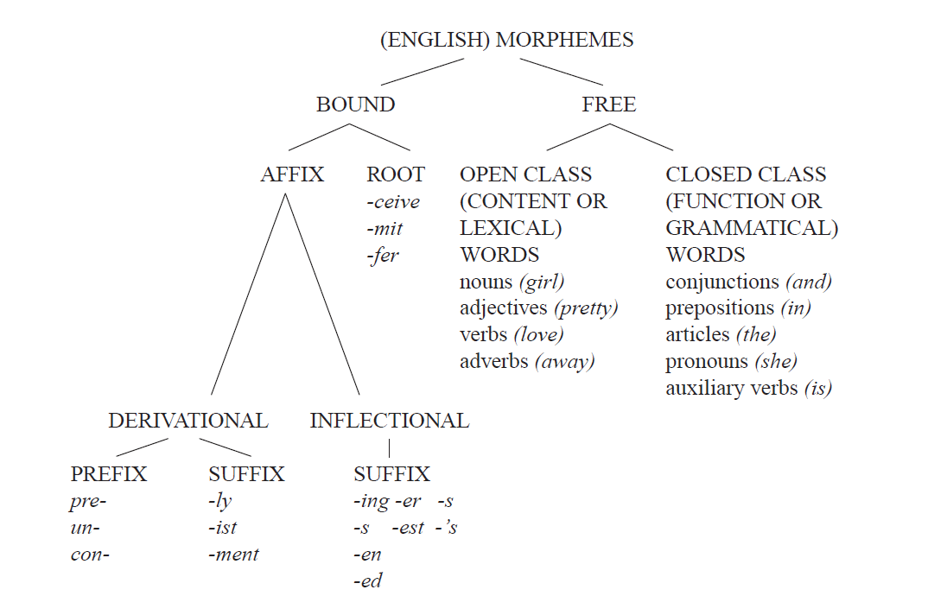
Chart of morpheme types

Slide 14
Exercise
Identify all the morphemes in the following sentence, and specify the category of each morpheme.
The musicians reconsidered their director’s unusual proposal.

Slide 15
Organization of morphemes
1. Morphemes are ordered in sequence.
unsystematic = un + system + atic
“reusable” and “unusable”

Slide 16
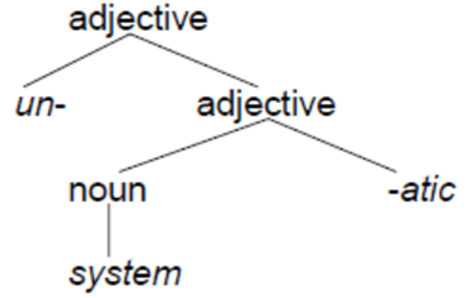
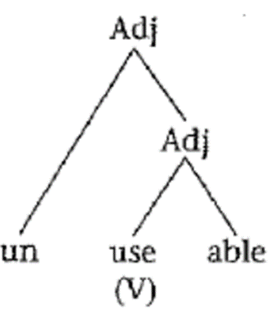
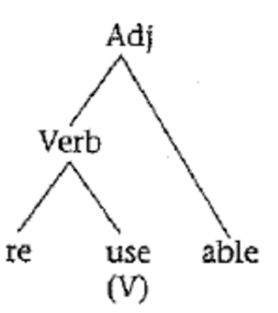
Organization of morphemes
2. Morphemes are ordered in hierarchical structure.
Two morphological rules:
– Noun + -atic → Adjective
– un- + Adjective → Adjective

Slide 17
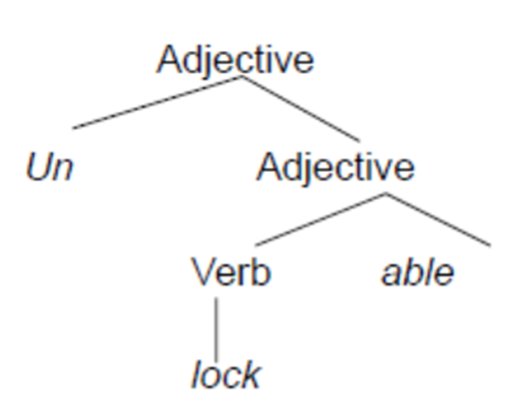
Organization of morphemes
3. explain the ambiguity of words
unlockable
1)“not able to be locked”

Slide 18
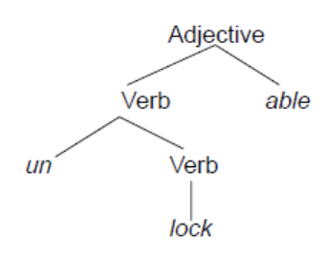
Organization of morphemes
unlockable
2) “able to be unlocked”

Slide 19
Organization of morphemes
Draw tree diagrams for the following words:
– unwrappable
– reconstruction

Slide 20
Organization of morphemes
4. Guessing the meaning of words
misclassify, whistle-blower
Your guesses may be wrong !
– deciduous
– bibliography
– gullible

Slide 21
Word-formation processes
Vocabulary!
common ways in which languages build more complex words out of morphemes：

Slide 22
Word-formation processes
Compounding
Derivation
Conversion
Blending
Backformation
Abbreviation
Borrowing
Coinage
Multiple processes

Slide 23
Compounding
Compounds: words formed by joining two or more free morphemes or words together
e.g. landlord, textbook, Facebook, blackboard, laptop, …
Two-word compounds are the most common, but there are compounds containing more then two words.
daughter-in-law
…

Slide 24
Compounding
Meaning of compounds
English compounds are typically right-headed.
traffic-cop, teapot, softball, driveway, headstrong, handpick, …
Many compounds are not right-headed.
overweight,
walkman
must-have

Slide 25
Compounding
The meaning of a compound is not always the sum of the meaning of its parts.
– Blackboard
– walkman
– Turncoat

Slide 26
Blending
A blend is formed through the combination of two or more other words in some ways.
Combining the beginning of a word and the end of another
– brunch: breakfast + lunch
– Chinglish: Chinese + English
– Brixit/Brexit: British exit or Britain exiting from the EU
Combing two words around a common sequence of sounds
– motel: motor + hotel
– smog: smoke + fog
– spork: spoon + fork

Slide 27
Blending
Combining the beginnings of both words
– modem: modulator + demodulator
– telex: teleprinter + exchange
Combing a word and part of the other word
foodoholic: food + alcoholic
workaholic:
fanzine: fan + magazine

Slide 28
Blending
Base word 1 | Base word 2 | Blend
boat | hotel | boatel
breakfast | lunch | brunch
channel | tunnel | chunnel
compressor | expander | compander
goat | sheep | geep
guess | estimate | guesstimate
sheep | goat | shoat
smoke | fog | smog
Spanish | English | Spanglish
stagnation | inflation | stagflation
Base word 1 | Base word 2 | Blend
breath | analyzer | breathalyzer
motor | camp | mocamp
motor | hotel | motel
science | fiction | sci-fi
high | fidelity | hi-fi
modulator | demodulator | modem

Slide 29
Derivation
forming a new word by adding affixes to an existing word
Prefix, suffix in English
act --- reaction
face --- facial
belief --- believe
breath--- breathe

Slide 30
Conversion (also functional shift or zero derivation)
Changing the function of a word and using it as a different part of speech without any corresponding formal change
N – V chair---chair the meeting
V, VP – N must, guess, handout

Slide 31
Conversion
The oil price hit a historical new high/low.
try our best to lower the living cost.
to better our English
The cost totals 3.5 million USD.
He bought a new BMW convertible.

Slide 32
Abbreviation
Abbreviation involves the shortening of existing words to create other words, usually informal versions of the originals.
1. Clipping /shortening
clipping the first part: phone, copter, chute,
clipping the last part: math, ad, dorm,
both the first and last part: flu
2. Initialism or Acronymy
WHO, UN, USA, USSR, CIS, BBC, VOA, CIA, FBI,
NATO, OPEC, APEC, GATT, UNESCO,

Slide 33
Backformation
A word of one type (usually a noun) is reduced to form another word of a different type (usually a verb).
Television: televise
Option: opt
Babysitter: babysit
editor: edit

Slide 34
Borrowing
Borrowing involves adopting a word from another language and incorporating it into another language.
Alcohol (Arabic), boss (Dutch), coup (French), blitzkrieg (German， a sudden military attack), robot (Czech), judo (Japanese), yogurt (Turkish), zebra (Bantu), kiwi (Australian aboriginal), tomato (American Indian), shampoo (Indian)…
What about Chinese?
Loan-translation or calque
Borrowing a word from another language by literal, word-for-word or root-for-root translation
Flea market: 跳蚤市场
Hot dog: 热狗

Slide 35
Coinage
The invention of totally new terms
The names of products or trade marks or brand names of a company becomes general terms.
Aspirin
Nylon
Zipper
Xerox (make a copy of…)

Slide 36
hypocorisms
a longer word is reduced to a single syllable, then -y or -ie is added to the end.
telly (‘television)
Aussie (‘Australian’)
barbie (‘barbecue’)
Chrissy pressies

Slide 37
Multiple Process
The creation of a word might involve several of the word-formation processes mentioned above.
Deli:
borrowing (delicatessen, from German) + clipping
Problems with the project snowballed.
Compounding + conversion
Waspish attitude (WASP: white Anglo-Saxon Protestant)

Slide 38
A summary
1. Morphological knowledge
morpheme
types of morphemes
organization of morphemes
2. Word-formation processes

Slide 39
Reading materials for the next week
Chapter 7 Grammar
Chapter 8 Syntax

Slide 40
References：
Fasold, R. W., & Connor-Linton, J. (Eds.). (2006). An introduction to language and linguistics. Cambridge university press.
Fromkin, V., Rodman, R., & Hyams, N. (2011). An introduction to language. Cengage Learning.
Hazen, K. (2014). An introduction to language. John Wiley & Sons.
Radford, A., Atkinson, M., Britain, D., Clahsen, H., & Spencer, A. (2009). Linguistics: an introduction. Cambridge University Press.
Yule, G. (2014). The study of language. Cambridge university press.
Among many other materials (including online materials)!

Slide 41
Thank you!
$

